Slide 1
Lecture 12
Advanced Combinational ATPG Algorithms
FAN – Multiple Backtrace (1983)
TOPS – Dominators (1987)
SOCRATES – Learning (1988)
Legal Assignments (1990)
EST – Search space learning (1991)
BDD Test generation (1991)
Implication Graphs and Transitive Closure (1988 - 97)
Recursive Learning (1995)
Test Generation Systems
Test Compaction
Summary

Slide 2
FAN -- Fujiwara and Shimono
(1983)
New concepts:
  Immediate assignment of uniquely-determined signals
  Unique sensitization
  Stop Backtrace at head lines
  Multiple Backtrace

Slide 3
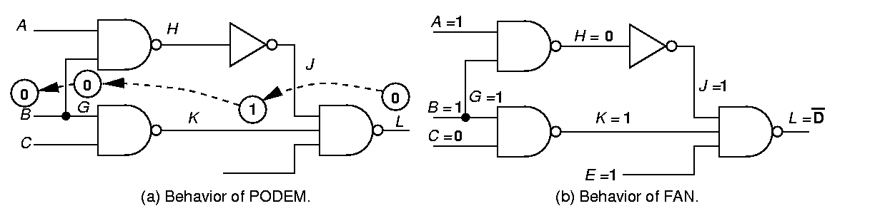
PODEM Fails to Determine Unique Signals
Backtracing operation fails to set all 3 inputs of gate L to 1
  Causes unnecessary search

Slide 4
FAN -- Early Determination of Unique Signals
Determine all unique signals implied by current decisions immediately
  Avoids unnecessary search

Slide 5
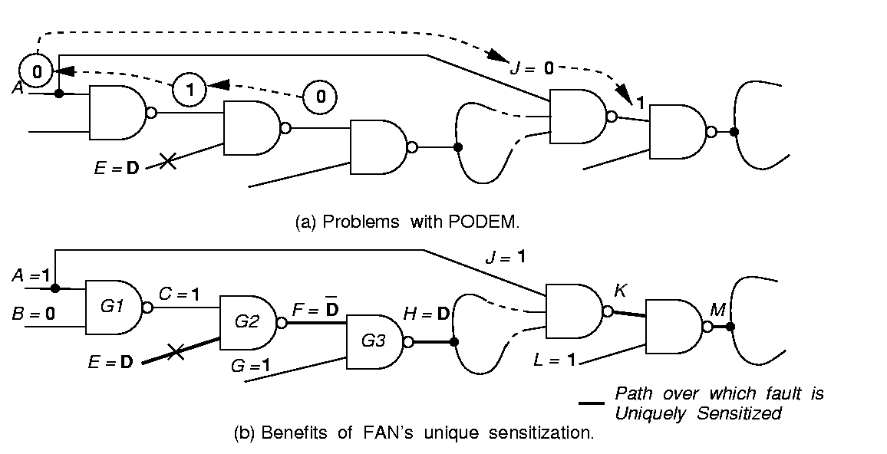
PODEM Makes Unwise Signal Assignments
Blocks fault propagation due to assignment J = 0

Slide 6
Unique Sensitization of FAN with No Search
Path over which fault is uniquely sensitized
FAN immediately sets necessary signals to propagate fault

Slide 7
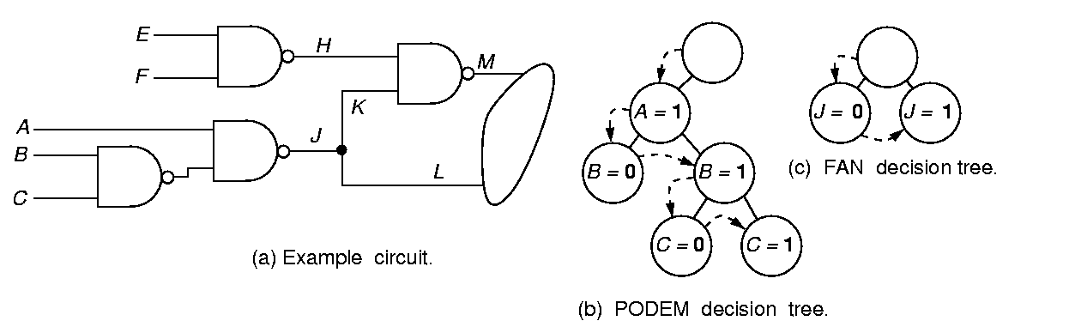
Headlines
Headlines H and J separate circuit into 3 parts, for which test generation can be done independently

Slide 8
Contrasting Decision Trees
FAN decision tree
PODEM decision tree

Slide 9
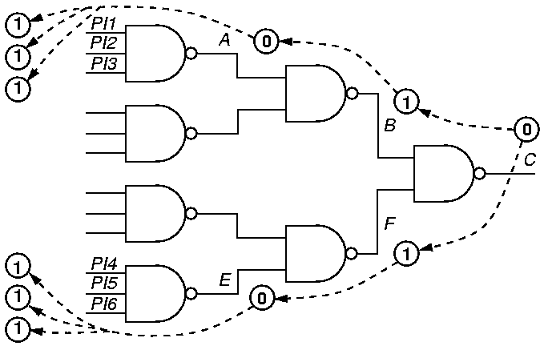
Multiple Backtrace
FAN – breadth-first
passes –
1 time
PODEM –
depth-first
passes – 6 times
_{PODEM – Depth-first search}
_{6 times}

Slide 10
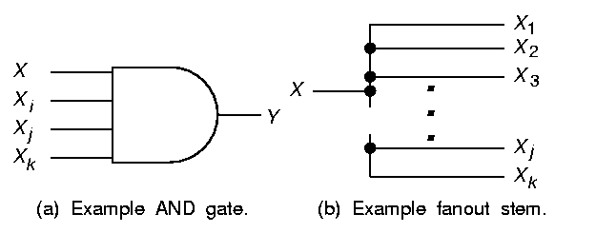
AND Gate Vote Propagation
[5, 3]
[0, 3]
[5, 3]
[0, 3]
[0, 3]
AND Gate
  Easiest-to-control Input –
    # 0’s = OUTPUT # 0’s
    # 1’s = OUTPUT # 1’s
  All other inputs --
    # 0’s = 0
    # 1’s = OUTPUT # 1’s

Slide 11
Multiple Backtrace Fanout Stem Voting
[5, 1]
[1, 1]
[18, 6]
[3, 2]
[4, 1]
[5, 1]
Fanout Stem --
  # 0’s = Σ Branch # 0’s,
  # 1’s = Σ Branch # 1’s

Slide 12
Multiple Backtrace Algorithm
repeat
  remove entry (s, v_{s}) from current_objectives;
  If (s is head_objective) add (s, v_{s}) to head_objectives;
  else if (s not fanout stem and not PI)
    vote on gate s inputs;
    if (gate s input I is fanout branch)
      vote on stem driving I;
      add stem driving I to stem_objectives;
    else add I to current_objectives;

Slide 13
Rest of Multiple Backtrace
  if (stem_objectives not empty)
    (k, n0 (k), n1 (k)) = highest level stem from stem_objectives;
    if (n0 (k) > n1 (k)) v_{k} = 0;
    else v_{k} = 1;
    if ((n0 (k) != 0) && (n1 (k) != 0) && (k not in fault
    cone))
      return (k, v_{k});
    add (k, v_{k}) to current_objectives;
    return (multiple_backtrace (current_objectives));
  remove one objective (k, v_{k}) from head_objectives;
  return (k, v_{k});

Slide 14
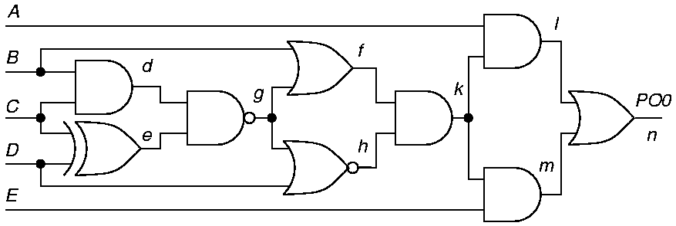
TOPS – Dominators
Kirkland and Mercer (1987)
Dominator of g – all paths from g to PO must pass through the dominator
  Absolute -- k dominates B
  Relative – dominates only paths to a given PO
  If dominator of fault becomes 0 or 1, backtrack

Slide 15
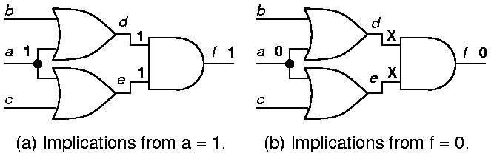
SOCRATES Learning (1988)
Static and dynamic learning:
a = 1 f = 1 means that we learn f = 0 a = 0
by applying the Boolean contrapositive theorem
  Set each signal first to 0, and then to 1
  Discover implications
  Learning criterion: remember f = v_{f} only if:
    f = v_{f} requires all inputs of f to be non-controlling
    A forward implication contributed to f = v_{f}

Slide 16
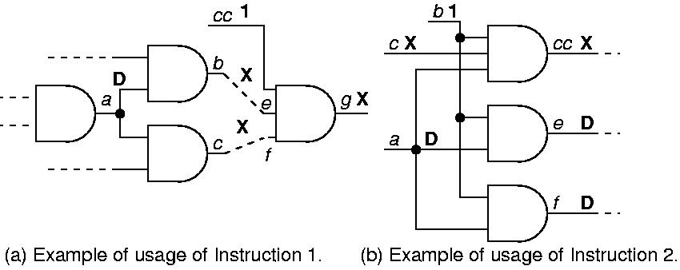
Improved Unique Sensitization Procedure
When a is only D-frontier signal, find dominators of a and set their inputs unreachable from a to 1
Find dominators of single D-frontier signal a and make common input signals non-controlling

Slide 17
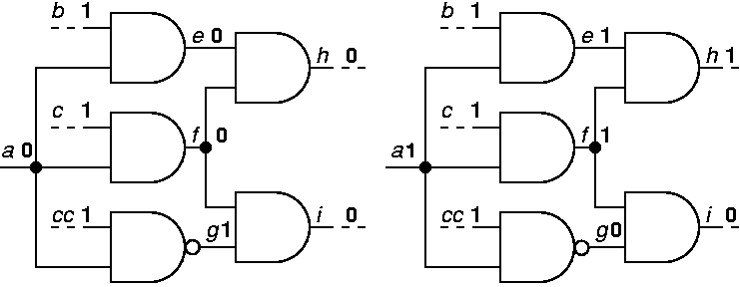
Constructive Dilemma
[(a = 0) (i = 0)] [(a = 1) (i = 0)] (i = 0)
If both assignments 0 and 1 to a make i = 0, then i = 0 is implied independently of a

Slide 18
Modus Tollens and Dynamic Dominators
Modus Tollens:
  (f = 1) [(a = 0) (f = 0)] (a = 1)
Dynamic dominators:
  Compute dominators and dynamically learned implications after each decision step
  Too computationally expensive

Slide 19
EST – Dynamic Programming (Giraldi & Bushnell)
E-frontier – partial circuit functional decomposition
  Equivalent to a node in a BDD
  Cut-set between circuit part with known labels and part with X signal labels
EST learns E-frontiers during ATPG and stores them in a hash table
  Dynamic programming – when new decomposition generated from implications of a variable assignment, looks it up in the hash table
  Avoids repeating a search already conducted
Terminates search when decomposition matches:
  Earlier one that lead to a test (retrieves stored test)
  Earlier one that lead to a backtrack
Accelerated SOCRATES nearly 5.6 times

Slide 20
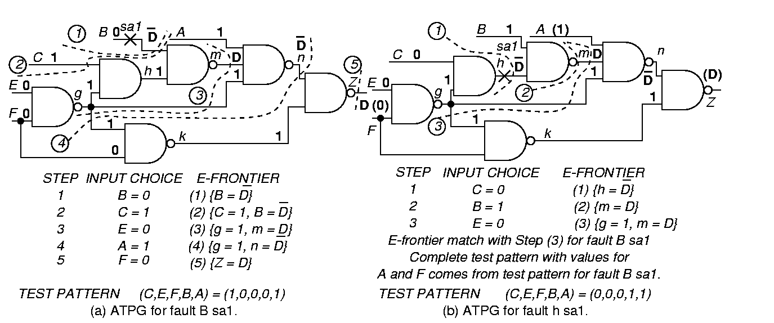
Fault B sa1

Slide 21
Fault h sa1

Slide 22
Implication Graph ATPG
Chakradhar et al. (1990)
Model logic behavior using implication graphs
  Nodes for each literal and its complement
  Arc from literal a to literal b means that if a = 1 then b must also be 1
Extended to find implications by using a graph transitive closure algorithm – finds paths of edges
  Made much better decisions than earlier ATPG search algorithms
  Uses a topological graph sort to determine order of setting circuit variables during ATPG

Slide 23
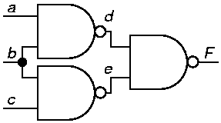
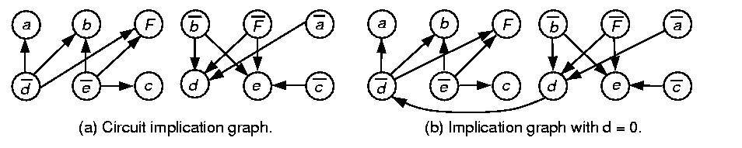
Example and Implication Graph

Slide 24
Graph Transitive Closure
When d set to 0, add edge from d to d, which means that if d is 1, there is conflict
  Can deduce that (a = 1) F
When d set to 1, add edge from d to d

Slide 25
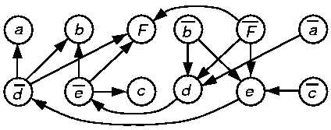
Consequence of F = 1
Boolean false function F (inputs d and e) has deF
For F = 1, add edge F F so deF reduces to d e
To cause de = 0 we add edges: e d and d e
  Now, we find a path in the graph b b
  So b cannot be 0, or there is a conflict
Therefore, b = 1 is a consequence of F = 1

Slide 26
Related Contributions
Larrabee – NEMESIS -- Test generation using satisfiability and implication graphs
Chakradhar, Bushnell, and Agrawal – NNATPG – ATPG using neural networks & implication graphs
Chakradhar, Agrawal, and Rothweiler – TRAN --Transitive Closure test generation algorithm
Cooper and Bushnell – Switch-level ATPG
Agrawal, Bushnell, and Lin – Redundancy identification using transitive closure
Stephan et al. – TEGUS – satisfiability ATPG
Henftling et al. and Tafertshofer et al. – ANDing node in implication graphs for efficient solution

Slide 27
Recursive Learning
Kunz and Pradhan (1992)
Applied SOCRATES type learning recursively
  Maximum recursion depth r_{max} determines what is learned about circuit
  Time complexity exponential in r_{max}
  Memory grows linearly with r_{max}

Slide 28
Recursive_Learning Algorithm
for each unjustified line
  for each input: justification
    assign controlling value;
    make implications and set up new list of unjustified lines;
    if (consistent) Recursive_Learning ();
  if (> 0 signals f with same value V for all consistent justifications)
    learn f = V;
    make implications for all learned values;
  if (all justifications inconsistent)
    learn current value assignments as consistent;

Slide 29
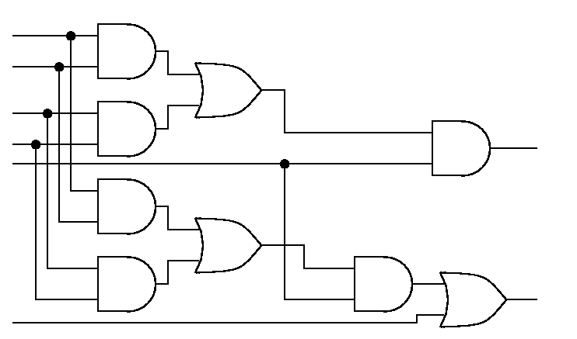
Recursive Learning
i1 = 0 and j = 1 unjustifiable – enter learning
a
a1
b
b1
e1
c
c1
f1
g1
i1 = 0
d
d1
h
h1
a2
b2
e2
c2
f2
g2
i2
d2
h2
j = 1
k

Slide 30
Justify i1 = 0
Choose first of 2 possible assignments g1 = 0
a
a1
b
b1
e1
c
c1
f1
g1 = 0
i1 = 0
d
d1
h
h1
a2
b2
e2
c2
f2
g2
i2
d2
h2
j = 1
k

Slide 31
Implies e1 = 0 and f1 = 0
Given that g1 = 0
a
a1
b
b1
e1 = 0
c
c1
g1 = 0
i1 = 0
d
d1
f1 = 0
h
h1
a2
b2
e2
c2
f2
g2
i2
d2
h2
j = 1
k

Slide 32
Justify a1 = 0, 1st Possibility
Given that g1 = 0, one of two possibilities
a
a1 = 0
b
b1
e1 = 0
c
c1
g1 = 0
i1 = 0
d
d1
f1 = 0
h
h1
a2
b2
e2
c2
f2
g2
i2
d2
h2
j = 1
k

Slide 33
Implies a2 = 0
Given that g1 = 0 and a1 = 0
a
a1 = 0
b
b1
e1 = 0
c
c1
g1 = 0
i1 = 0
d
d1
f1 = 0
h
h1
a2 = 0
b2
e2
c2
f2
g2
i2
d2
h2
j = 1
k

Slide 34
Implies e2 = 0
Given that g1 = 0 and a1 = 0
a
a1 = 0
b
b1
e1 = 0
c
c1
g1 = 0
i1 = 0
d
d1
f1 = 0
h
h1
a2 = 0
b2
e2 = 0
c2
f2
g2
i2
d2
h2
j = 1
k

Slide 35
Now Try b1 = 0, 2nd Option
Given that g1 = 0
a
a1
b
b1 = 0
e1 = 0
c
c1
g1 = 0
i1 = 0
d
d1
f1 = 0
h
h1
a2
b2
e2
c2
f2
g2
i2
d2
h2
j = 1
k

Slide 36
Implies b2 = 0 and e2 = 0
Given that g1 = 0 and b1 = 0
a
a1
b
b1 = 0
e1 = 0
c
c1
g1 = 0
i1 = 0
d
d1
f1 = 0
h
h1
a2
b2 = 0
e2 = 0
c2
f2
g2
i2
d2
h2
j = 1
k

Slide 37
Both Cases Give e2 = 0, So Learn That
a
a1
b
b1
e1 = 0
c
c1
g1 = 0
i1 = 0
d
d1
f1 = 0
h
h1
a2
b2
e2 = 0
c2
f2
g2
i2
d2
h2
j = 1
k

Slide 38
Justify f1 = 0
Try c1 = 0, one of two possible assignments
a
a1
b
b1
e1 = 0
c
c1 = 0
g1 = 0
i1 = 0
d
d1
f1 = 0
h
h1
a2
b2
e2 = 0
c2
f2
g2
i2
d2
h2
j = 1
k

Slide 39
Implies c2 = 0
Given that c1 = 0, one of two possibilities
a
a1
b
b1
e1 = 0
c
c1 = 0
g1 = 0
i1 = 0
d
d1
f1 = 0
h
h1
a2
b2
e2 = 0
c2 = 0
f2
g2
i2
d2
h2
j = 1
k

Slide 40
Implies f2 = 0
Given that c1 = 0 and g1 = 0
a
a1
b
b1
e1 = 0
c
c1 = 0
g1 = 0
i1 = 0
d
d1
f1 = 0
h
h1
a2
b2
e2 = 0
c2 = 0
g2
i2
d2
f2 = 0
h2
j = 1
k

Slide 41
Try d1 = 0
Try d1 = 0, second of two possibilities
a
a1
b
b1
e1 = 0
c
c1
g1 = 0
i1 = 0
d
d1 = 0
f1 = 0
h
h1
a2
b2
e2 = 0
c2
f2
g2
i2
d2
h2
j = 1
k

Slide 42
Implies d2 = 0
Given that d1 = 0 and g1 = 0
a
a1
b
b1
e1 = 0
c
c1
g1 = 0
i1 = 0
d
d1 = 0
f1 = 0
h
h1
a2
b2
e2 = 0
c2
f2
g2
i2
d2 = 0
h2
j = 1
k

Slide 43
Implies f2 = 0
Given that d1 = 0 and g1 = 0
a
a1
b
b1
e1 = 0
c
c1
g1 = 0
i1 = 0
d
d1 = 0
f1 = 0
h
h1
a2
b2
e2 = 0
c2
g2
i2
d2 = 0
f2 = 0
h2
j = 1
k

Slide 44
Since f2 = 0 In Either Case, Learn f2 = 0
a
a1
b
b1
e1
c
c1
g1 = 0
i1 = 0
d
d1
f1
h
h1
a2
b2
e2 = 0
c2
g2
i2
d2
f2 = 0
h2
j = 1
k

Slide 45
Implies g2 = 0
a
a1
b
b1
e1
c
c1
g1 = 0
i1 = 0
d
d1
f1
h
h1
a2
b2
e2 = 0
c2
g2 = 0
i2
d2
f2 = 0
h2
j = 1
k

Slide 46
Implies i2 = 0 and k = 1
a
a1
b
b1
e1
c
c1
g1 = 0
i1 = 0
d
d1
f1
h
h1
a2
b2
e2 = 0
c2
g2 = 0
i2 = 0
d2
f2 = 0
h2
j = 1
k = 1

Slide 47
Justify h1 = 0
Second of two possibilities to make i1 = 0
a
a1
b
b1
e1
c
c1
f1
g1
i1 = 0
d
d1
h
h1 = 0
a2
b2
e2
c2
f2
g2
i2
d2
h2
j = 1
k

Slide 48
Implies h2 = 0
Given that h1 = 0
a
a1
b
b1
e1
c
c1
f1
g1
i1 = 0
d
d1
h
h1 = 0
a2
b2
e2
c2
f2
g2
i2
d2
h2 = 0
j = 1
k

Slide 49
Implies i2 = 0 and k = 1
Given 2nd of 2 possible assignments h1 = 0
a
a1
b
b1
e1
c
c1
f1
g1
i1 = 0
d
d1
h
h1 = 0
a2
b2
e2
c2
f2
g2
i2 = 0
d2
h2 = 0
j = 1
k = 1

Slide 50
Both Cases Cause k = 1 (Given j = 1), i2 = 0
a1
Therefore, learn both independently
a
b
b1
e1
c
c1
f1
g1
i1 = 0
d
d1
h
h1
a2
b2
e2
c2
f2
g2
i2 = 0
d2
h2
j = 1
k = 1

Slide 51
Other ATPG Algorithms
Legal assignment ATPG (Rajski and Cox)
  Maintains power-set of possible assignments on each node {0, 1, D, D, X}
BDD-based algorithms
  Catapult (Gaede, Mercer, Butler, Ross)
  Tsunami (Stanion and Bhattacharya) – maintains BDD fragment along fault propagation path and incrementally extends it
  Unable to do highly reconverging circuits (parallel multipliers) because BDD essentially becomes infinite

Slide 52
Fault Coverage and Efficiency
# of detected faults
Total # faults
Fault coverage =
Fault
efficiency
=
# of detected faults
Total # faults -- # undetectable faults

Slide 53
Test Generation Systems
Circuit
Description
Fault
List
Compacter
SOCRATES
With fault
simulator
Aborted
Faults
Test
Patterns
Undetected
Faults
Redundant
Faults
Backtrack
Distribution

Slide 54
Test Compaction
Fault simulate test patterns in reverse order of generation
  ATPG patterns go first
  Randomly-generated patterns go last (because they may have less coverage)
  When coverage reaches 100%, drop remaining patterns (which are the useless random ones)
  Significantly shortens test sequence – economic cost reduction

Slide 55
Static and Dynamic Compaction of Sequences
Static compaction
  ATPG should leave unassigned inputs as X
  Two patterns compatible – if no conflicting values for any PI
  Combine two tests t_{a} and t_{b} into one test t_{ab} = t_{a} t_{b} using D-intersection
  Detects union of faults detected by t_{a} & t_{b}
Dynamic compaction
  Process every partially-done ATPG vector immediately
  Assign 0 or 1 to PIs to test additional faults

Slide 56
Compaction Example
t₁ = 0 1 X t₂ = 0 X 1
t₃ = 0 X 0 t₄ = X 0 1
Combine t₁ and t₃, then t₂ and t₄
Obtain:
  t₁₃ = 0 1 0 t₂₄ = 0 0 1
Test Length shortened from 4 to 2

Slide 57
Summary
Test Bridging, Stuck-at, Delay, & Transistor Faults
  Must handle non-Boolean tri-state devices, buses, & bidirectional devices (pass transistors)
Hierarchical ATPG -- 9 Times speedup (Min)
  Handles adders, comparators, MUXes
  Compute propagation D-cubes
    Propagate and justify fault effects with these
  Use internal logic description for internal faults
Results of 40 years research – mature – methods:
  Path sensitization
  Simulation-based
  Boolean satisfiability and neural networks

